Slide 1
A Component Platform for Experimenting with Autonomic Composition
Françoise Baude, Ludovic Henrio, and Paul Naoumenko
A component framework for supporting composition of autonomic services and bio-inspired composition
Programming models and software point of view
Autonomic service adaptation (e.g. to context)

Slide 2
Platform Requirements
Software/services structure and representation for composition and adaptation of services
Interaction framework: supporting and implementing autonomic services
Resource/service discovery (only support)
Algorithm/strategy (only support)

Slide 3
Agenda
Programming models for autonomic systems
Our proposal: GCM components
Deploying bio-inspired autonomic systems with the GCM
  GCM component model
  Adaptation by reconfiguration
  Decoupling components

Slide 4
Programming Models as a basis for Autonomic frameworks (1/4)
SOA / simple Workflow
  Easy to invoke services
  Composition in time
  Adapted to service discovery or simple compositions
  Weak structure
  Simple data-flow dependencies: (typed) input / output
More complex workflows exist, but closer to components

Slide 5
Programming Models as a basis for Autonomic frameworks (2/4)
Aspect oriented programming
  Efficiently plug non-functional concerns
  Good separation of aspects
  Dependencies insufficiently specified, incomplete dynamic adaptation (functional)
Functional code
+
Aspects
Application

Slide 6
Programming Models as a basis for Autonomic frameworks (3/4)
Rule-based adaptation
  Rich evolution expressivity
  Generally designed for planned evolutions,
  Which underlying structure? Which actions?
If condition then action

Slide 7
Our Proposal
GCM (Grid Component Model) as a basic programming model
+ features from preceding frameworks
  Components ➔ structured
  Autonomous entities
  Separation of concerns
  Adaptation = reconfiguration (of the composition)
  Easy to implement autonomic behaviors,
  e.g. rule based acting on the components
Our goal: adapt the GCM component model to autonomic adaptation of component/service composition

Slide 8
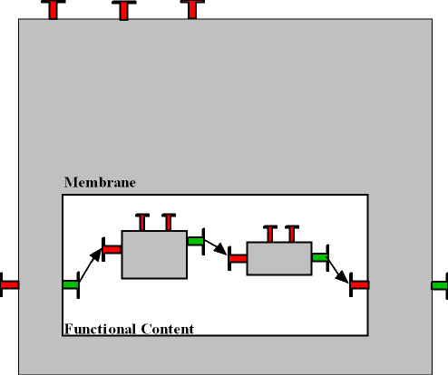
Global Component Structure in the GCM
A composite component
Non-functional interfaces
Bindings
Primitive
component
Functional interfaces
Sub-
component
Components are distributed autonomous entities

Slide 9
Short Summary of the GCM
Hierarchical and extensible component model
Support for distribution and extended communication patterns - Especially asynchronous method calls
Multicast/Gathercast specification + implementation: collective communications: 1 to N and N to 1, MxN
« Component Oriented SPMD »
Deployment of components
Components in the membrane
Autonomicity as a non-functional concern
GCM = component model spec.
ProActive/GCM = one implementation (reference)

Slide 10
Functional reconfiguration

Slide 11
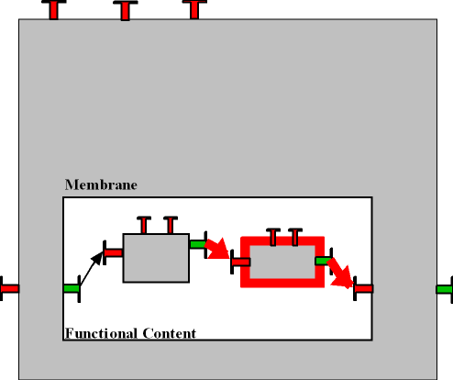
Functional reconfiguration

Slide 12
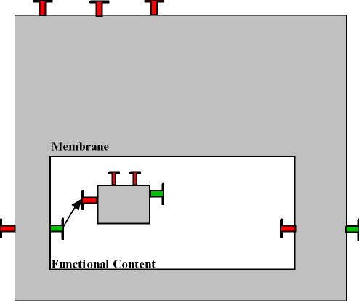
Functional reconfiguration

Slide 13
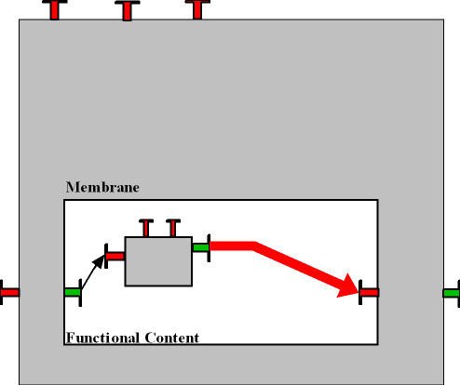
Functional reconfiguration

Slide 14
What is Reconfiguration in GCM?
Adding/removing a component inside a composite (content controller)
Binding/unbinding two components (binding controller)
  Involves compatibility checks (type-checking,…)
Higher level reconfiguration primitives can be designed (e.g. replace)
Generally it is mandatory to stop a component before reconfiguring it.
  Start/stop primitives (lifecycle controller)

Slide 15
Adaptation in the GCM
Functional adaptation: adapt the architecture+behaviour of the application to new requirements/objectives
  Modify the architecture (applicative)
Non-functional adaptation: adapt the architecture of the container+middleware to changing environment/NF requirements (QoS …)
  Change communication protocol
  Update security policy
  …
Objective:
Adaptation expressed as component reconfiguration
Can be triggered by a rule engine

Slide 16
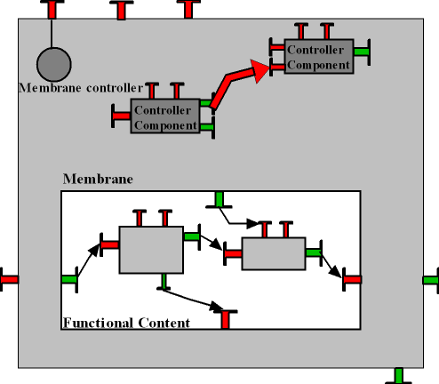
Non-functional Component Structure
Non-functional aspects as a composition of components (inside a membrane)
  A component structure for the membrane
  New kind of interfaces and bindings
  An API for reconfiguring
  the membrane
  Non-functional code is
    components or objects
    distributed or not
Both functional and non-functional adaptation are expressed as reconfigurations

Slide 17
This is still too static!
There is no composition in time in the GCM
GCM applications are generally deployed at once from an ADL
Strong constraints on connectivity for better guaranteed properties
For autonomic systems, loose coupling is necessary
  Communications
  Composition
Objective: suppress some of the constraints related to components
But keeping its properties: safety / programmability

Slide 18
Decoupling Communications
[ProActive, AmbientTalk]
Asynchronous communications with futures in GCM/ProActive
Can be improved by a sending queue
(disconnected mode)

Slide 19
Loosely Coupled Composition
Composition plan (similar to workflow, but for components)
  Composition (ADL) is not instantiated, just stored, and used when needed
Depending on components/conditions, components can be:
  Discovered, or
  Instantiated, or
  Instantiated if no corresponding service already exist
Relies on:
  Service discovery at runtime (based on composition plan)
  Composition plan repository or creation (upon need) of composition plans
  Mediators to solve type/interfaces mismatch (cf. well-known works on component adaptation)

Slide 20
Programming Models as a basis for Autonomic frameworks (4/4)
GCM Component-model (a hierarchical component model with strong and structured separation of concerns)
  Distributed component model ➔ autonomous entities
  Good structure, hierarchical
  Interaction model: well-defined interfaces
  good separation of concerns
  Support for reconfiguration (adaptation)
  Can export services
  Supports autonomic evolution
    take into account rule-based evolution
  Composition in time
    Composition plan / workflow

Slide 21
Where is Biology? ➔ in Adaptation
Consider the composition plan as a genotype: (valid) genes are component descriptions (e.g. in a repository)
The rule engine can express bio-inspired kind of reconfiguration
  Mutation as replacement,
  or evolution inside the component
  Crossover as 2 replacements
Requires compatibility checks (typing)
Autonomicity is programmed in the membrane and controls both the membrane and the content

Slide 22
Why GCM Components for Bio-inspired Autonomous Systems?
Component structure ➔ well defined interfaces/interactions
Components are autonomous self-manageable entities
Hierarchical structure for better managing autonomicity (top-down / bottom-up)
Evolution strategy as a Non-functional component
  Pluggable/evolvable evolution strategy
  Experiment with coexistence of several evolution strategies
Thank you!
Questions?

